Slide 1

E-COMMERCE SHOPPING BEHAVIOUR AMONG ICFAI University Jharkhand STUDENTS
UNDER THE SUPERVISION OF : Dr . DILIP KUMAR
BY : SUMAN KUMARI
B.COM
UID : 22FHUCJHN01004

Slide 2
CONTENT
INTRODUCTION OF E-COMMERCE
E-COMMERCE COMPANIES IN INDIA
RESEARCH METHODLOGY
DATA ANALYSIS AND INTERPRETATION
FINDINGS
CONCLUSION
BIBLIOGRAPHY
THANK YOU

Slide 3

INTRODUNTION
WHAT IS E-COMMERCE??
Integration of web and telecommunication technologies for purpose Of selling and buying products or services over the internet.
E-COMMERCE CLASSIFICATION
B2B/B2G (e.g. McMaster, Fastenal)
B2C (e.g. Flip cart, Amazon etc.)
C2C (e.g. Olx.com )
C2B (e.g. Elance.com)

Slide 4


TYPES OF E-COMMERCE
Business to Business ( B2B) : It is a transaction or business conducted
Between one business and another, such as a wholesaler and retailer.
BUSINESS TO CONSUMER: It refers to the process of selling products
And services directly between a business and consumers who are the
End-users of its products or services.

Slide 5


3. CONSUMER TO BUSINESS (C2B): It is a type of e-commerce where a
Consumer, end user provides a product or services to an organization.
4. CONSUMER TO CONSUMER (C2C): It is a type of e-commerce in which
Consumers trade products, services and information with each other online.
Generally conducted through a third party that provides an online platform
On which the transactions are carried out.

Slide 6
E-Commerce
Companies in India

Slide 7

Amazon.com, is an American multinational technology company based in settle, Washington that focuses in e-commerce, cloud computing, digital streaming and artificial intelligence.
Its net worth as of the August 04,2023 is $1432.04 billion.
It provides services as follows Alexa, Appstore , Luna, Music, Pay, Prime ,Prime Video, Twitch, Ring, Webserices, Robotics.
Its principle is customer obsession rather than competitors focus passion for invention, and long term thinking.

Slide 8

Flipkart private Limited is an Indian e-commerce , headquartered in Bangalore, and incorporated in Singapore as a private limited company.
Filpkart is valued at $37.6 billion as of 2022.
As of March 2017, Filpkart held a 39.5% market share in the India e-commerce industry.
Filpkart was reported to be at top in the annual Fairwork India Ratings 2021 which is a 10 point system that creates a score based on fair pay, conditions, contracts, management and representation.

Slide 9
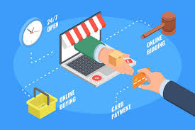
ADVANTAGES OF E-COMMEMRCE
Increased convenience
Increased reach
Easier shopping experience
Improved customer relationship
Cost savings
Improved efficiency
Increased visibility
Ability to handle multiple purchase
Detailed product information
Available 24*7

Slide 10
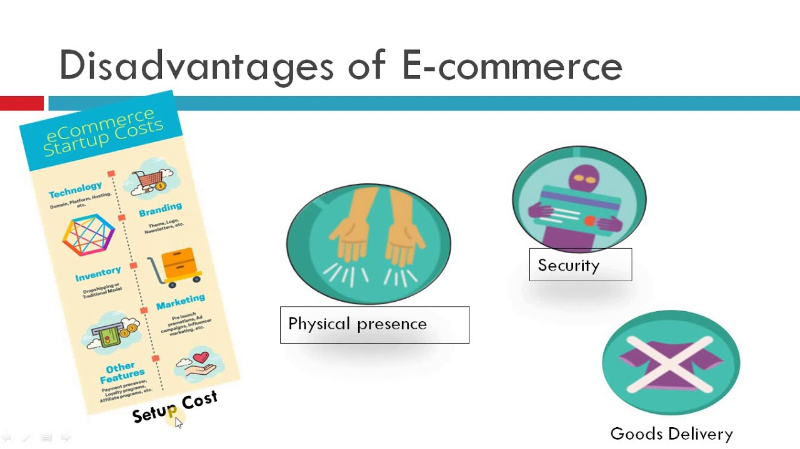
DISADVA4NTAGES OF E-COMMERCE
Lack of personal touch
Long delivery period
No guarantee about product quality
Security issues
Additional charges (taxes, shipping) are high
Some items are hard to purchase online
Risk of fraud
Long distance delivery cost is very high

Slide 11
RESEARCH METHODLOGY
Reseacher’s collected the data for our research project, we look at how people interact with each other.
We have conducted online survey through Google form where we have covered this campus student, and asked the personal review.
After this, I went through many websites and survey and collect all the data necessary to
the topic .
Finally, I made direct observation of my resand classmates to see how they present
themselves.
Throughout, these methods I have been able to make some conclusion and few generalization about e-commerce usage and potential impact and those who use online shopping.

Slide 12
DATA ANALYSIS AND INTERPRETATION
Researcher collected data from 42 respondents through Google form.
1. Gender
Interpretation: Out of 100% users of e-commerce , 76% were male and 24% were female.

Slide 13
2.
Interpretation: In the above pie chart shown 47.6% people use flip kart and 35.7% people use Amazon and 11.9% people use other online platform Because the user experience on flip kart when ordering, checking out, and making a payment is far better than on Amazon. Also, flip kart offer a good discount on many of the product available which you hardly and did on another website.

Slide 14
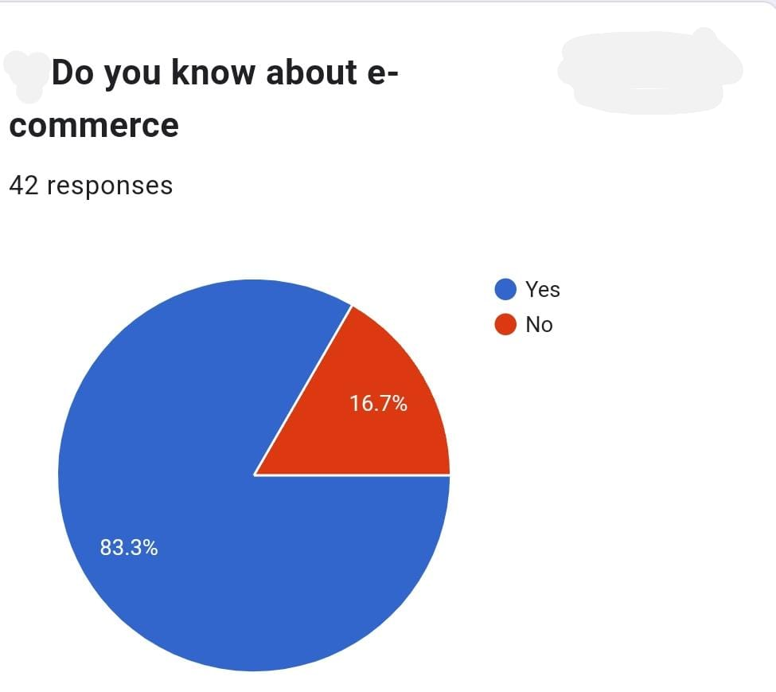
Out of 100% of my survey, 83.3% people know about E-commerce and only 16.7% people don’t know about E-commerce because of illiteracy and these are mainly belonging to rural area

Slide 15
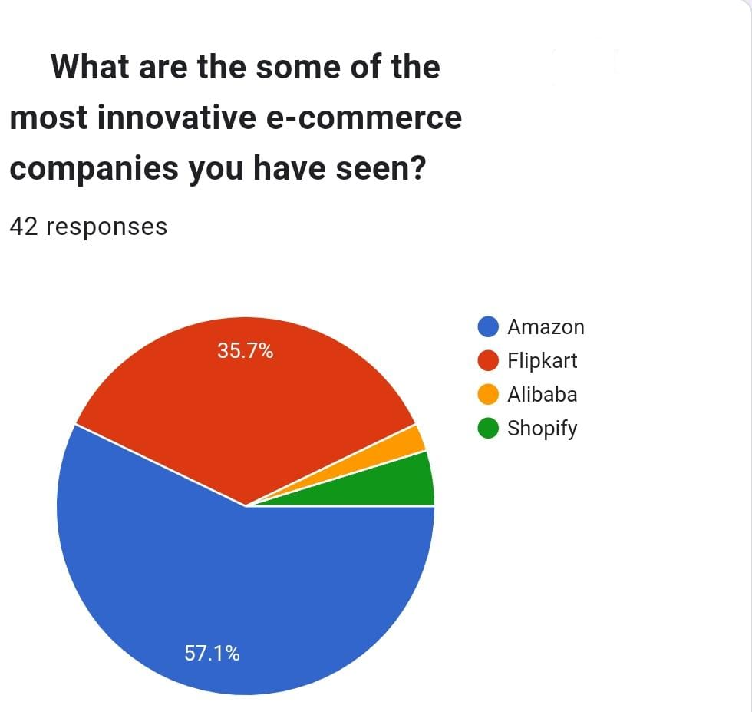
In this pie chart shown that mostly (57.1%) people said Amazon is more innovative than the flipchart (35.7%) and other online website (7.2%) Because Amazon innovate itself in term of concepts, methodologies their technology and this increased competition has forced Amazon to continually innovate and improve its offerings to stay ahead of competition. Amazon prime is an integral part of the company’s business model and continues to be a significant driver of growth.

Slide 16
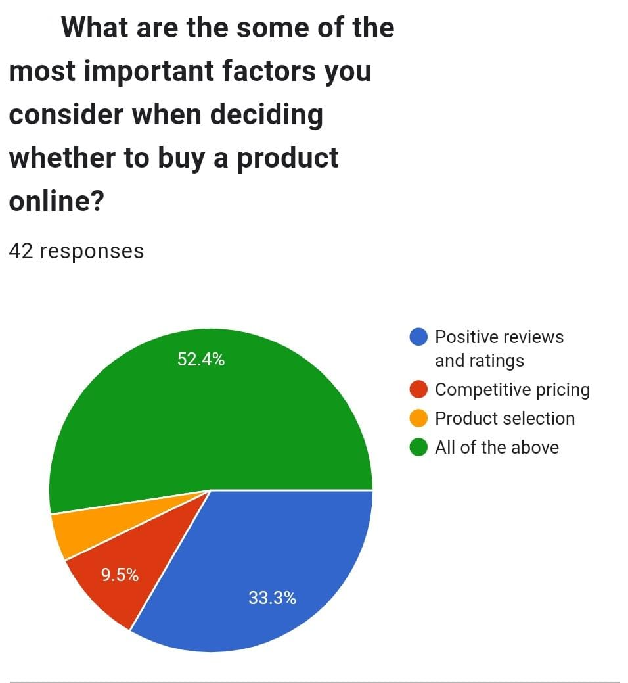
During online shopping or before purchasing any product they generally see the positive reviews of the product or competitive pricing according to below pie chart.

Slide 17
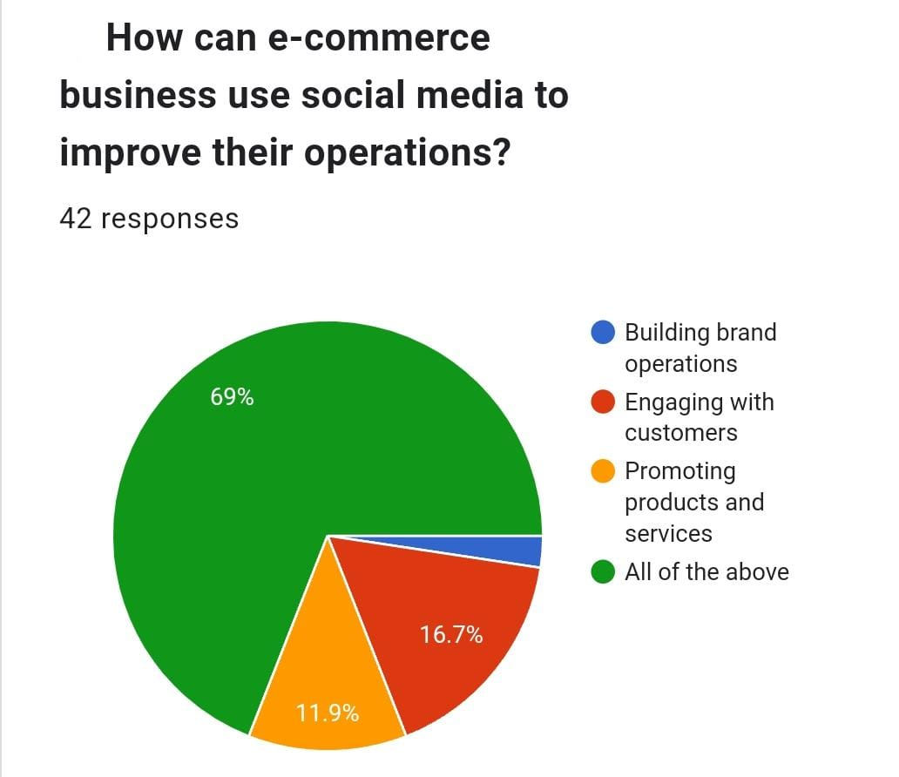
Social media also help to promote e-commerce like to promote their product and services also engage with customers and advertise to target user segments.

Slide 18
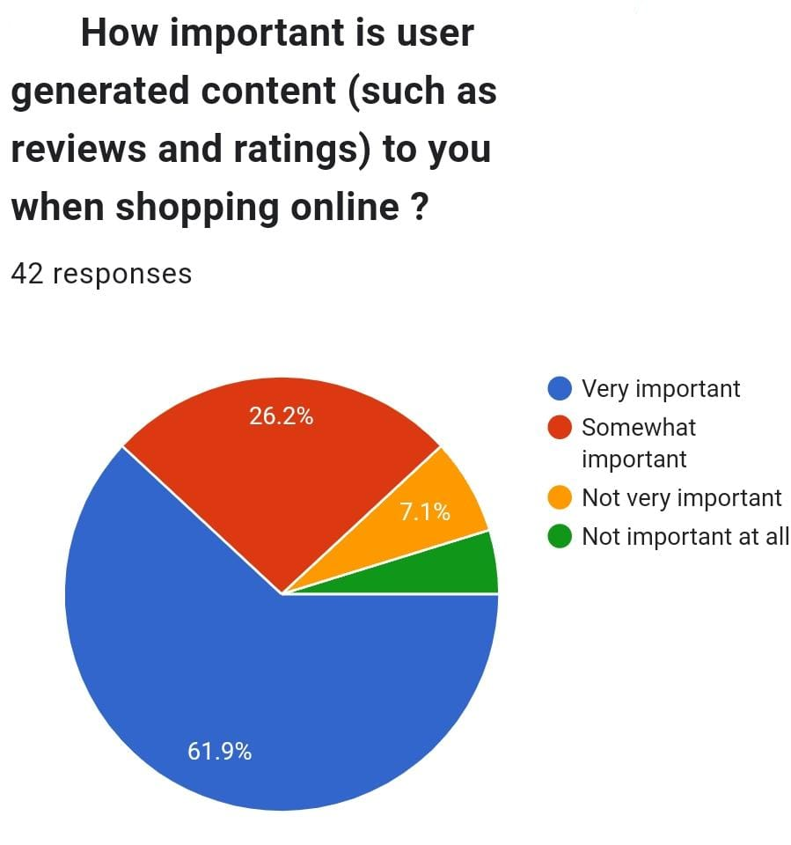
Below pie chart many people said reviews and ratings are very important during purchase any products its gives the product information and people experience.

Slide 19
50%) People said there is positive impact on E-commerce during COVID 19: here is some positive impact –growth of new online shoppers, adoption of contactless payments methods such as mobile wallets and digital payment platform, Increase demand for delivery service to minimize physical interactions. Many of the changes and adaptations made during this period are likely to have lasting effects on how people shop and do business online.
But some people said (28.6%) there is negative impact on E-commerce during COVID 19: here is some negative impact on E-commerce – a) shipping challenges – this resulted in shipping delays and higher shipping costs for both business and customers, b) cyber security risks – this increased reliance on online shopping also led a rise in cybercrime and online scams and uncertainty surrounding the pandemic to launch phishing attacks and fraud schemes which affecting both businesses and customers.
And some of people said (4.7) there is no impact on Ecommerce but it is not accurate to say there is no impact on E-commerce. The pandemic had a substantial impact on ecommerce industry, both positive and negative, as mentioned in above statement and (16.7%) people not sure or not aware that COVID19 impact E-commerce industry.

Slide 20
FINDINGS
Researcher collected data from 42 respondents through Google form.
Out of 100% users of e-commerce , 76% were male and 24% were female.
47.6% people use flip kart and 35.7% people use Amazon and 11.9% people use other online platform Because the user experience on flip kart when ordering, checking out, and making a payment is far better than on Amazon. Also, flip kart offer a good discount on many of the product available which you hardly and did on another website.
Out of 100% of my survey, 83.3% people know about E-commerce and only 16.7% people don’t know about E-commerce because of illiteracy and these are mainly belonging to rural area
In this pie chart shown that mostly (57.1%) people said Amazon is more innovative than the flipchart (35.7%) and other online website (7.2%) Because Amazon innovate itself in term of concepts, methodologies their technology and this increased competition has forced Amazon to continually innovate and improve its offerings to stay ahead of competition. Amazon prime is an integral part of the company’s business model and continues to be a significant driver of growth.

Slide 21
During online shopping or before purchasing any product they generally see the positive reviews of the product or competitive pricing according to below pie chart.
Social media also help to promote e-commerce like to promote their product and services also engage with customers and advertise to target user segments.
Below pie chart many people said reviews and ratings are very important during purchase any products its gives the product information and people experience.

Slide 22
CONCLUSION
In conclusion, the impact of e-commerce on shopping behavior has been profound and transformative. The rapid advancement of technology, the widespread availability of the internet, and the convenience of online shopping have reshaped the way consumers interact with businesses and make purchasing decisions.
Throughout this essay, we have explored various aspects of e-commerce shopping behavior. We've seen how factors like website design, user experience, and personalized recommendations play crucial roles in influencing consumer choices. Additionally, the emergence of mobile commerce and social media has further expanded the avenues through which businesses can engage with their customers.
Furthermore, the COVID-19 pandemic accelerated the adoption of e-commerce as consumers sought safer alternatives to traditional brick-and-mortar shopping. This shift in behavior has led businesses to adapt and optimize their online platforms to meet the evolving demands of the digital marketplace.
While e-commerce offers unprecedented convenience and accessibility, it also presents challenges in terms of data privacy, cyber security, and ensuring a seamless shopping experience. As technology continues to evolve, businesses must stay vigilant and responsive to the changing needs and expectations of their customers.

Slide 23
BIBLIOGRAPHY
WIKIPEDIA
GOOGLE
EBOOKS

Slide 24
THANK YOU

